Slide 1


ACCT 2003 Intermediate Financial Accounting 中级财务会计
THE HITSZ
SCHOOL OF ECONOMICS
AND MANAGEMENT
授课人：墙伟
2024.9.9

Slide 2

LEARNING OBJECTIVES
CHAPTER 8
Valuation of Inventories: A Cost-Basis Approach
After studying this lecture, you should be able to:
Compare the cost flow assumptions used to account for inventories.
Determine the effects of inventory errors on the financial statements.
Notes:
Inventories are of particular importance to merchandising and manufacturing companies because they represent the primary source of revenue for the organization. Inventories are also significant because of their impact on both the statement of financial position and the income statement.

Slide 3

单选题
1分
Recap
1. Where should raw materials be classified on the statement of financial position?
此题未设置答案，请点击右侧设置按钮
A
Prepaid expenses
B
Inventory
C
Equipment
D
Not on the statement of financial position
Submit

Slide 4
单选题
1分
Recap
2. Which of the following items should be included in a company's inventory at the balance sheet date?
此题未设置答案，请点击右侧设置按钮
A
Goods in transit which were purchased f.o.b. shipping point
B
Goods received from another company for sale on consignment
C
Goods sold to a customer that is being held for the customer to call for at his or her convenience
D
Goods sold to a customer that was shipped f.o.b. shipping point
Submit

Slide 5
LEARNING OBJECTIVE 3
Compare the cost flow assumptions used to account for inventories.
Notes:
Determining the specific cost of inventory items that have been sold as well as those remaining in ending inventory is sometimes a difficult process. This is due, in part, to the fact that there is no requirement that the cost flow assumption adopted needs to be consistent with the physical flow of the goods through the inventory account. Thus, it is important when accounting for inventory costs that an entity makes consistent use of a cost flow assumption. The major objective in selecting a method should be to choose the one which most clearly reflects periodic income.

Slide 6
Which Cost Flow Assumptions to Adopt?
Cost Flow Methods 成本流转假设
Specific Identification 个别计价法
or
Two cost flow assumptions
First-in, First-out (FIFO) 先进先出法 or
Average Cost 平均成本法
LO 3
Notes:
During any given fiscal period, companies typically purchase merchandise at several different prices. If a company prices inventories at cost and it made numerous purchases at different unit costs, which cost should it use?
Conceptually, a specific identification of the given items sold and unsold seems optimal. (L.O. 3) The IASB requires the use of the specific identification method, which is not a cost flow assumption when inventories are not interchangeable or for goods and services produced or segregated for specific projects.
Only in situations where inventory turnover is low, unit price is high, or inventory quantities are small are the specific identification criteria met.
In other cases, inventory should be measured using one of two cost flow assumptions: (a) first-in, first-out (FIFO) or (b) average-cost. It should be remembered that these assumptions relate to the flow of costs and not the physical flow of inventory items into and out of the company.

Slide 7
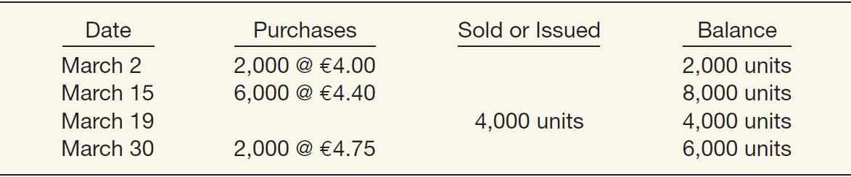
Cost Flow Methods
which price or prices should it assign to the 6,000 units of ending inventory?
To illustrate the cost flow methods, assume that Call-Mart SpA had the following transactions in its first month of operations.
Calculate Goods Available for Sale 可供出售商品成本
Beginning inventory (2,000 x €4) € 8,000
Purchases:
6,000 x €4.40 26,400
2,000 x €4.75 9,500
Goods available for sale €43,900
LO 3
Notes:
From this information, Call-Mart computes the ending inventory of 6,000 units and the cost of goods available for sale (beginning inventory + purchases) of €43,900 [(2,000 @ €4.00) + (6,000 @ €4.40) + (2,000 @ €4.75)]. The question is, which price or prices should it assign to the 6,000 units of ending inventory? The answer depends on which cost flow assumption it uses.
The question is, which price or prices should it assign to the 6,000 units of ending inventory? The answer depends on which cost flow assumption it uses.

Slide 8
Cost Flow Methods
Specific Identification 个别计价法
Method may be used only in instances where it is practical to separate physically the diﬀerent purchases made. Cost of goods sold includes costs of the specific items sold.
Used when handling a relatively small number of costly, easily distinguishable items.
Matches actual costs against actual revenue.
Cost flow matches the physical flow of the goods.
May allow a company to manipulate net income.
LO 3
Notes:
In the retail trade, this includes some types of jewelry, fur coats, automobiles, and some furniture.
In manufacturing, it includes special orders and many products manufactured under a job cost system.

Slide 9
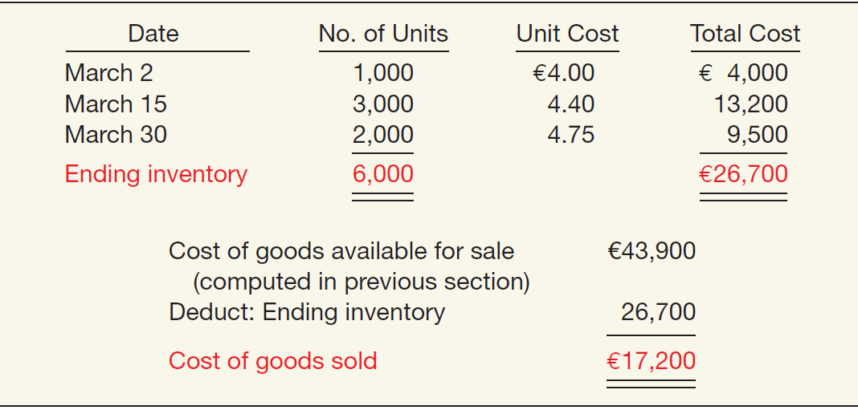

Specific Identification
Illustration: Call-Mart Inc.’s 6,000 units of inventory consists of 1,000 units from the March 2 purchase, 3,000 from the March 15 purchase, and 2,000 from the March 30 purchase. Compute the amount of ending inventory and cost of goods sold.
ILLUSTRATION 8.7
LO 3
Notes:
In other words, under specific identification the cost flow matches the physical flow of the goods.

Slide 10
Specific Identification
Illustration: Call-Mart Inc.’s 6,000 units of inventory consists of 1,000 units from the March 2 purchase, 3,000 from the March 15 purchase, and 2,000 from the March 30 purchase. Compute the amount of ending inventory and cost of goods sold.
ILLUSTRATION 8.7
可供出售商品成本
期末存货成本
主营业务成本
LO 3
Notes:
This method appears ideal. Specific identification matches actual costs against actual revenue. Thus, a company reports ending inventory at actual cost.
In other words, under specific identification the cost flow matches the physical flow of the goods.
Some argue that specific identification allows a company to manipulate net income. For example, assume that a wholesaler purchases identical plywood early in the year at three different prices. When it sells the plywood, the wholesaler can select either the lowest or the highest price to charge to expense. It simply selects the plywood from a specific lot for delivery to the customer. A business manager, therefore, can manipulate net income by delivering to the customer the higher- or lower-priced item, depending on whether the company seeks lower or higher reported earnings for the period.
Another problem relates to the arbitrary allocation of costs that sometimes occurs with specific inventory items. For example, a company often faces difficulty in relating freight charges, storage costs, and discounts directly to a given inventory item. This results in allocating these costs somewhat arbitrarily, leading to a “breakdown” in the precision of the specific identification method.

Slide 11
Cost Flow Methods
Average-Cost 平均成本法
Prices items in the inventory on the basis of the average cost of all similar goods available during the period.
Not as subject to income manipulation.
Measuring a specific physical flow of inventory is often impossible.
LO 3
Notes:
Items in the ending inventory and items sold are priced at the average cost of goods available during the period. Either weighted average (periodic) or moving average (perpetual) procedures may be used.

Slide 12
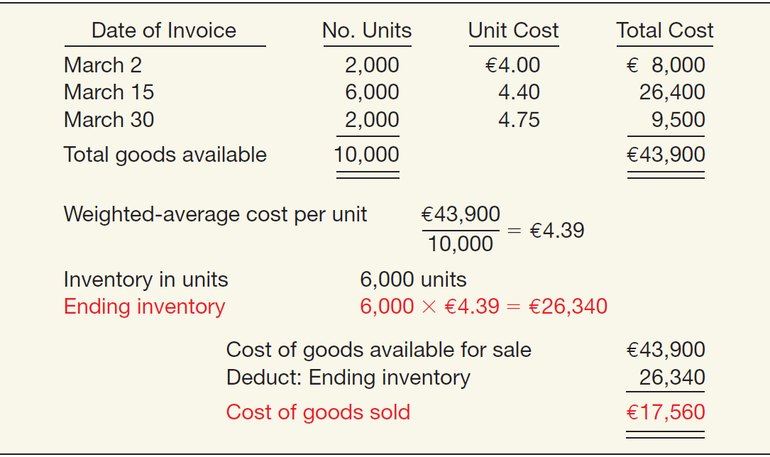
Average-Cost ( Periodic Inventory 定期盘存制 )
Weighted-Average Method
加权平均法
ILLUSTRATION 8.8
Weighted-Average
Method—Periodic Inventory
加权平均单位成本
LO 3
Notes:
Under the periodic inventory method, the average-cost method is implemented as a weighted-average method.
A weighted-average cost per unit is computed as (total cost of goods available/total number of units available). This weighted-average cost per unit is multiplied times the number of units in ending inventory to determine the ending inventory cost. The difference between the total cost of goods available and the ending inventory cost is the cost of goods sold.

Slide 13
Average-Cost (Periodic Inventory定期盘存制 )
Weighted-Average Method
加权平均法
ILLUSTRATION 8.8
Weighted-Average
Method—Periodic Inventory
加权平均单位成本
期末存货
主营业务成本
LO 3
Notes:
Under the periodic inventory method, the average-cost method is implemented as a weighted-average method.
A weighted-average cost per unit is computed as (total cost of goods available/total number of units available). This weighted-average cost per unit is multiplied times the number of units in ending inventory to determine the ending inventory cost. The difference between the total cost of goods available and the ending inventory cost is the cost of goods sold.

Slide 14
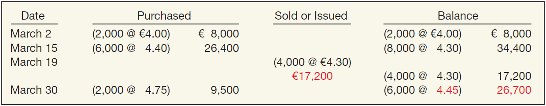
Average-Cost (Perpetual Inventory 永续盘存制)
Moving-Average Method
移动加权平均法
ILLUSTRATION 8.9
Moving-Average Method—Perpetual Inventory
In this method, Call-Mart computes a new average unit cost each time it makes a purchase.
LO 3
Notes:
Under the perpetual inventory method, the average-cost method is implemented as a moving-average method. A new weighted-average cost per unit is computed each time a purchase is made.
That average cost per unit is used to cost all subsequent sales until another purchase is made, at which time a new weighted-average cost per unit is calculated. Therefore, the cost of goods sold and ending inventory cost is known all the time.

Slide 15
Average-Cost (Perpetual Inventory 永续盘存制)
Moving-Average Method
移动加权平均法
ILLUSTRATION 8.9
Moving-Average Method—Perpetual Inventory
In this method, Call-Mart computes a new average unit cost each time it makes a purchase.
LO 3
Notes:
Under the perpetual inventory method, the average-cost method is implemented as a moving-average method. A new weighted-average cost per unit is computed each time a purchase is made. That average cost per unit is used to cost all subsequent sales until another purchase is made, at which time a new weighted-average cost per unit is calculated. Therefore, the cost of goods sold and ending inventory cost is known all the time.
In this method, Call-Mart computes a new average unit cost each time it makes a purchase. For example, on March 15, after purchasing 6,000 units for €26,400, Call-Mart has 8,000 units costing €34,400 (€8,000 plus €26,400) on hand. The average unit cost is €34,400 divided by 8,000, or €4.30.
Call-Mart uses this unit cost in costing withdrawals until it makes another purchase. At that point, Call-Mart computes a new average unit cost. Accordingly, the company shows the cost of the 4,000 units withdrawn on March 19 at €4.30, for a total cost of goods sold of €17,200.
On March 30, following the purchase of 2,000 units for €9,500, Call-Mart determines a new unit cost of €4.45, for an ending inventory of €26,700.

Slide 16
Cost Flow Methods
First-In, First-Out (FIFO) 先进先出法
Assumes goods are used in the order in which they are purchased.
Approximates the physical flow of goods.
At the same time, it prevents manipulation of income.
Ending inventory is close to current cost.
Fails to match current costs against current revenues on the income statement.
LO 3
Notes:
The use of the FIFO inventory method assumes that the first goods purchased are the first used or sold. In all cases where FIFO is used, the inventory and cost of goods sold would be the same at the end of the month whether a perpetual or periodic system is used.
A major advantage of the FIFO method is that the ending inventory is stated in terms of an approximate current cost figure. However, because FIFO tends to reflect current costs on the statement of financial position, a basic disadvantage of this method is that current costs are not matched against current revenues on the income statement. A company charges the oldest costs against the more current revenue, possibly distorting gross profit and net income.
When the physical flow of goods is actually first-in, first-out, the FIFO method closely approximates specific identification.
Although a company may use a variety of inventory methods to assist in accurate computation of net income, once it selects a pricing method, it must apply it consistently thereafter.

Slide 17
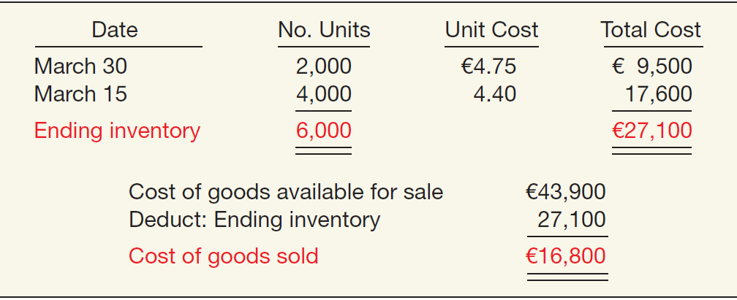
First-In, First-Out (FIFO)
Periodic Inventory System
定期盘存制
ILLUSTRATION 8.10
FIFO Method—Periodic
Inventory
Determine cost of ending inventory by taking the cost of the most recent purchase and working back until it accounts for all units in the inventory.
LO 3
Notes:
Under the periodic method, the FIFO method computes the ending inventory and cost of goods sold at the end of an accounting period. The ending inventory cost is determined by determining the number on hand at the end of the period by taking a physical count, and then starting with the last purchase, working backwards through the purchases for the period, until all of the units on hand have been costed. The cost of goods sold is the difference between the cost of goods available and the ending inventory.

Slide 18
First-In, First-Out (FIFO)
Periodic Inventory System
定期盘存制
ILLUSTRATION 8.10
FIFO Method—Periodic
Inventory
期末存货
主营业务成本
Determine cost of ending inventory by taking the cost of the most recent purchase and working back until it accounts for all units in the inventory.
LO 3
Notes:
Under the periodic method, the FIFO method computes the ending inventory and cost of goods sold at the end of an accounting period. The ending inventory cost is determined by determining the number on hand at the end of the period by taking a physical count, and then starting with the last purchase, working backwards through the purchases for the period, until all of the units on hand have been costed. The cost of goods sold is the difference between the cost of goods available and the ending inventory.

Slide 19
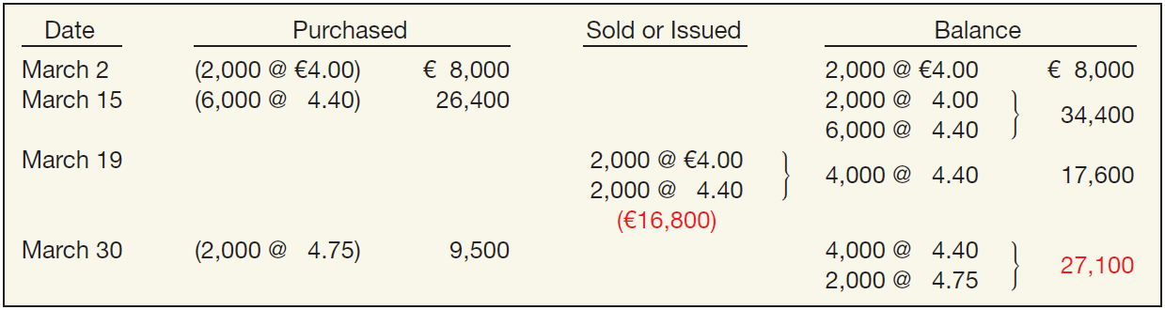
First-In, First-Out (FIFO)
Perpetual Inventory System
永续盘存制
ILLUSTRATION 8.11
FIFO Method—
Perpetual Inventory
In all cases where FIFO is used, the inventory and cost of goods sold would be the same at the end of the month whether a perpetual or periodic system is used.
LO 3
Notes:
Under the perpetual inventory method, the cost of goods sold is determined for each sale, starting with the first units on hand at the time of the sale and working forward until the units sold have been costed. The ending inventory cost consists of the costs attached to the units remaining. So, both the ending inventory and the cost of goods sold are known throughout the period.

Slide 20
First-In, First-Out (FIFO)
Perpetual Inventory System
永续盘存制
ILLUSTRATION 8.11
FIFO Method—
Perpetual Inventory
In all cases where FIFO is used, the inventory and cost of goods sold would be the same at the end of the month whether a perpetual or periodic system is used.
LO 3
Notes:
Under the perpetual inventory method, the cost of goods sold is determined for each sale, starting with the first units on hand at the time of the sale and working forward until the units sold have been costed. The ending inventory cost consists of the costs attached to the units remaining. So, both the ending inventory and the cost of goods sold are known throughout the period.

Slide 21
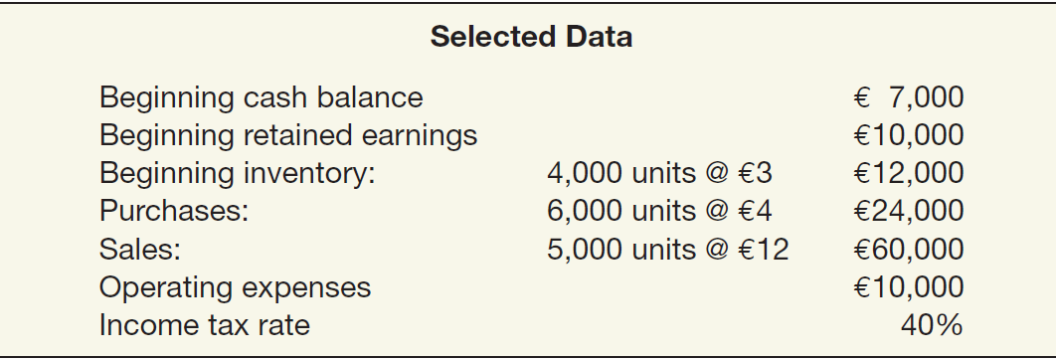
Inventory Valuation Methods—Summary
Comparison assumes periodic inventory procedures and the following selected data.
LO 3
Notes:
The preceding sections of this chapter described a number of inventory valuation methods. Here, we present a brief summary of the two commonly used inventory cost flow methods to show the effects these valuation methods have on the financial statements. This comparison assumes periodic inventory procedures and the following selected data.

Slide 22
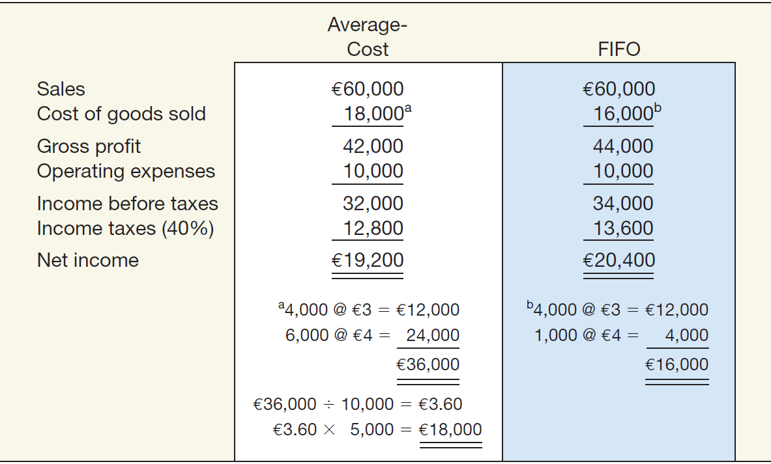
Inventory Valuation Methods—Summary
Notice that gross profit and net income are higher under FIFO compared to average-cost because prices are increasing.
平均成本法
先进先出法
主营业务收入
主营业务成本
毛利
营业费用
税前利润
所得税
净利润
ILLUSTRATION 8.12
Comparative Results of
Average-Cost and FIFO
Methods
LO 3
Notes:
Illustration 8.12 shows the comparative results on net income of the use of average-cost and FIFO.

Slide 23
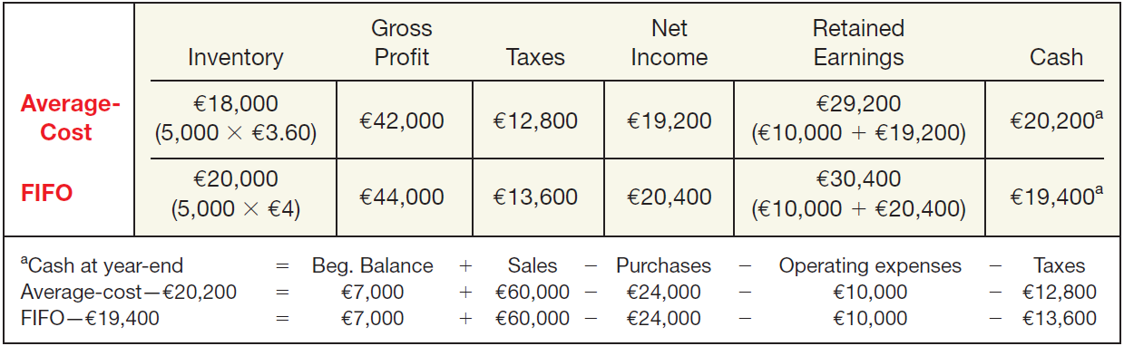
Inventory Valuation Methods—Summary
When prices are rising, average-cost results in the higher cash balance at year-end (because taxes are lower).
ILLUSTRATION 8.13
Balances of Selected Items under Alternative Inventory Valuation Methods
LO 3

Slide 24
单选题
1分
Quick Check
Which method of inventory pricing best approximates specific identification of the actual flow of costs and units in most manufacturing situations?
此题未设置答案，请点击右侧设置按钮
A
Average cost
B
First-in, first-out
C
Moving-average
D
Weighted-average
Submit

Slide 25
单选题
1分
此题未设置答案，请点击右侧设置按钮
Recap
Assuming that perpetual inventory records are kept in units only, the ending inventory on an average-cost basis, rounded to the nearest euro, is
Transactions for the month of June were:
Purchases Sale
June 1 800 @ €3.20 June 2 600 @ €5.50
3 2,200 @ 3.10 6 1,600 @ 5.50
7 1,200 @ 3.30 9 1,000 @ 5.50
15 1,800 @ 3.40 10 400 @ 6.00
22 500 @ 3.50 18 1,400 @ 6.00
25 200 @ 6.00
A
€4,096.
B
€4,238.
C
€4,290.
Submit
D
€4,322.

Slide 26


感谢您的参与！
THE HITSZ
SCHOOL OF ECONOMICS
AND MANAGEMENT

